Slide 1
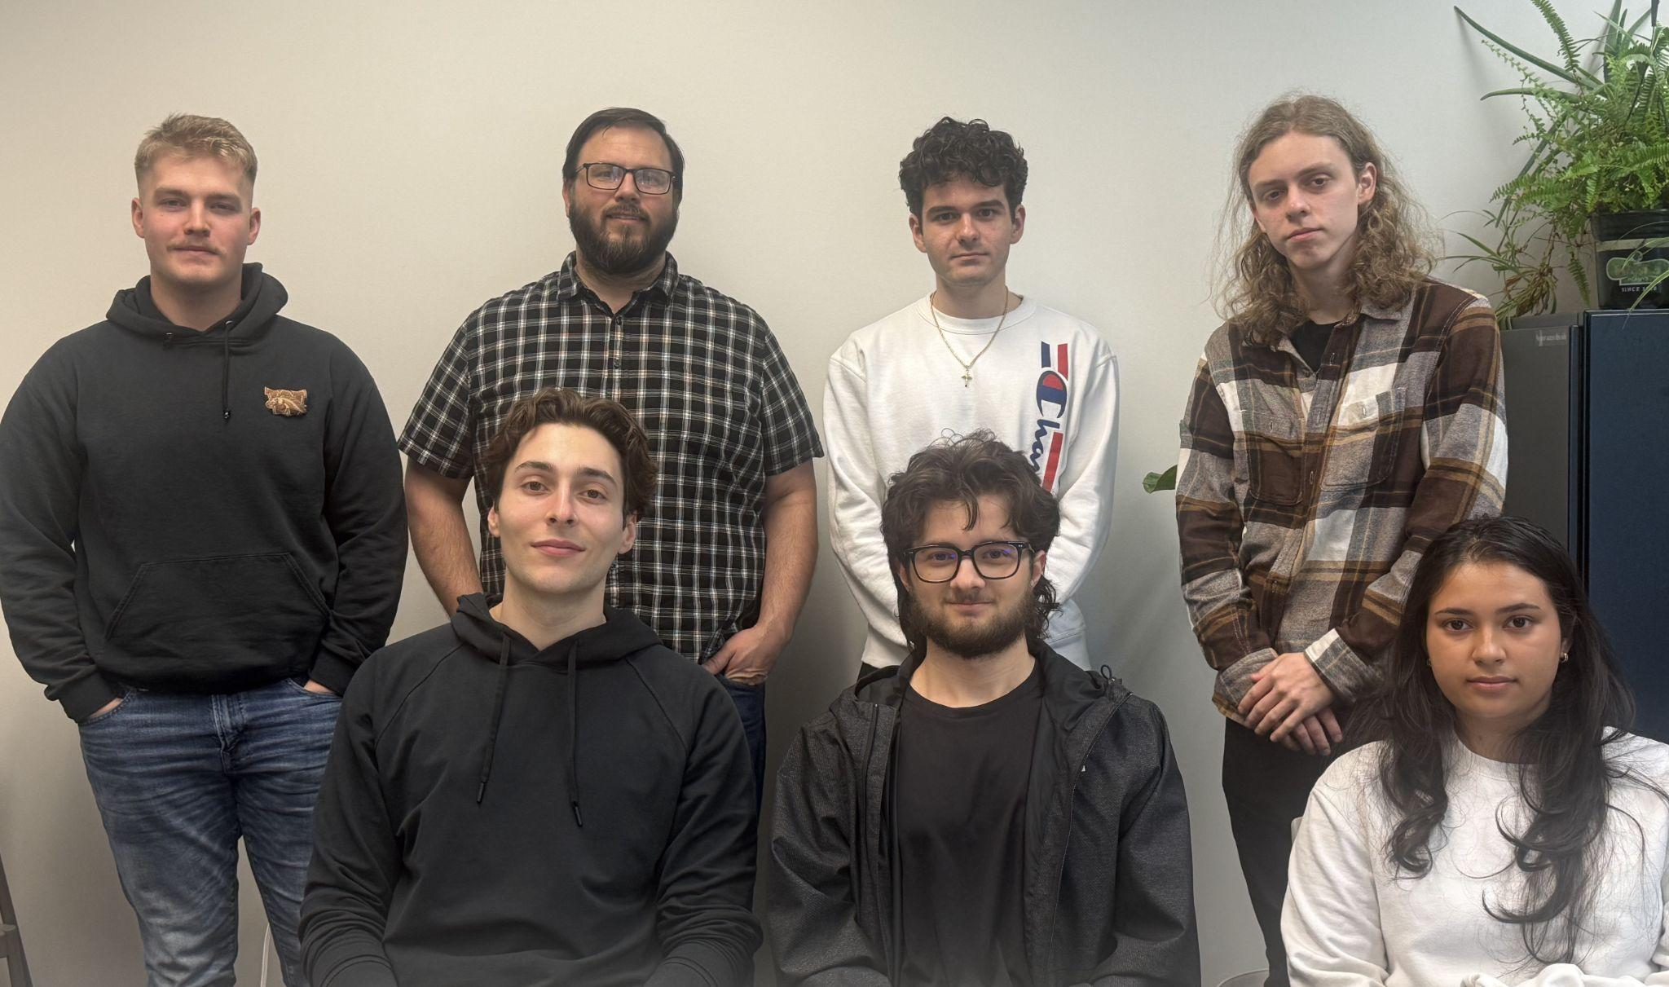

MakiMate
ME/ECE 4999
Group 9
Mahfuja Jannat | James Lauritsen | Danilo Zdravkovic | Jackson Mabry | Eric Janowiecki | Nate Anderson | Lawrence Dokaj

Slide 2
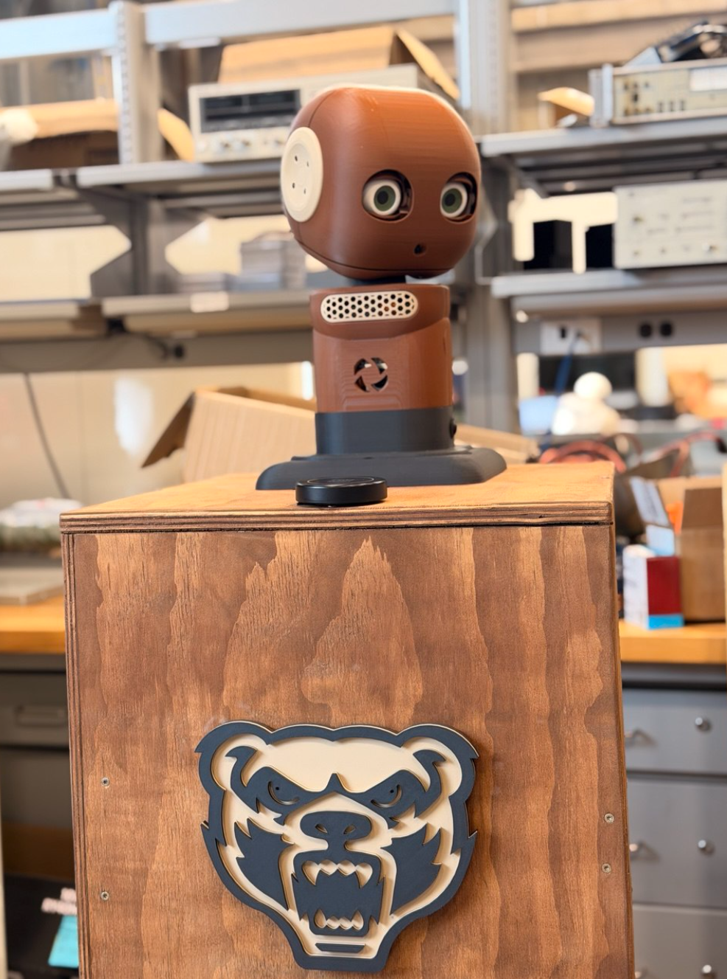




What is MakiMate?
Group 9
Open Source Social Robot
Low Cost and Reproducable
ROS2 Based and Customizeable
Built for Natural Interaction

Slide 3
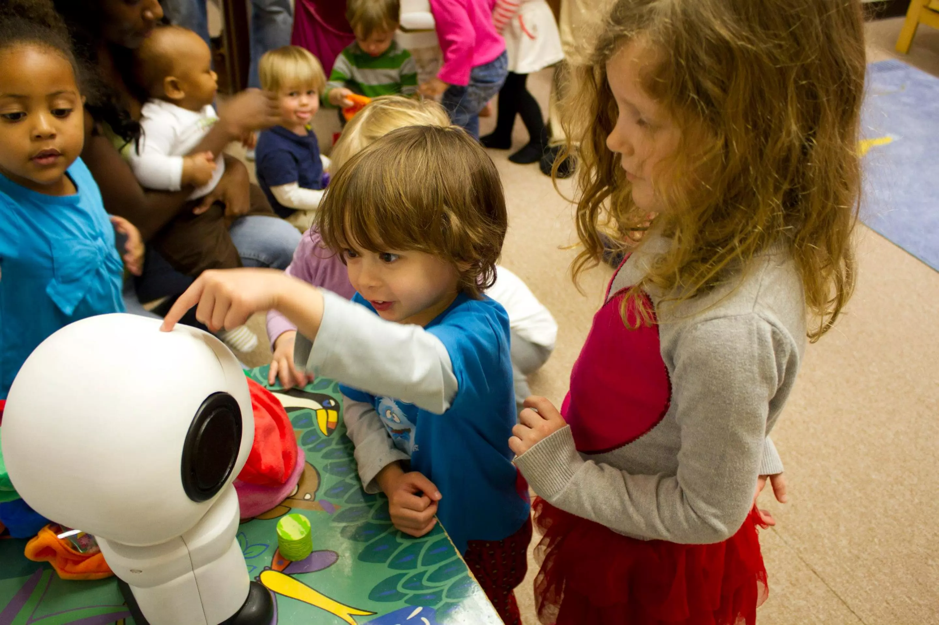
The Team’s Deliverables
Group 9
Speaker identification in noisy environment
Addition of arms and torso redesign
Implementation of customizable LLM

Slide 4
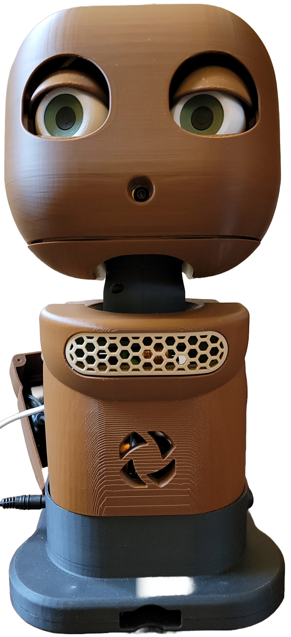

System Overview
Expressive Eyes
Camera tracks user attention
External mic and internal speaker enable diolouge
Six servos drive expression
Raspberry Pi coordinates behavior
Camera
Neck Yaw/Pitch
Internal Hardware (Pi, Speaker, Motor Drivers)
Power Supply

Slide 5
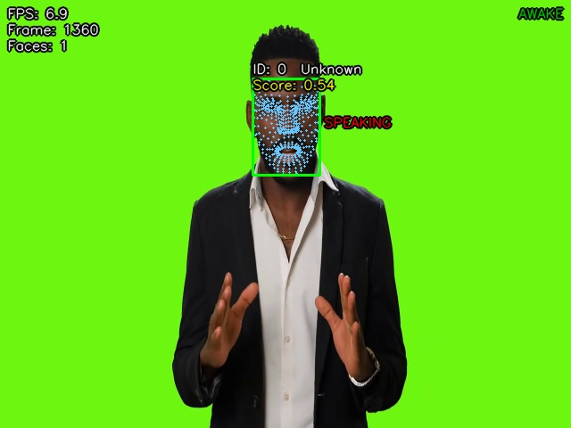
Hearing & Seeing
Group 9
30% improved accuracy
Layered noise filtering
Locked gaze
  85% speaker turn accuracy
  1.2s switching latency

Slide 6
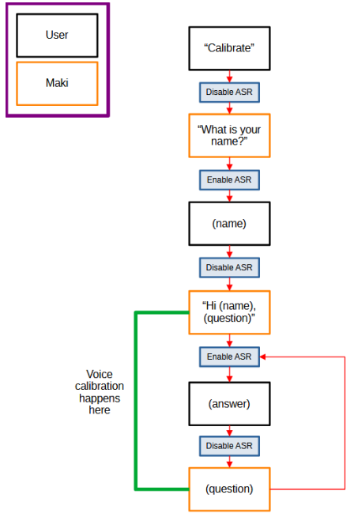
Personalization
Group 9
Calibration sequence
Creates user profiles
Social robot feature

Slide 7
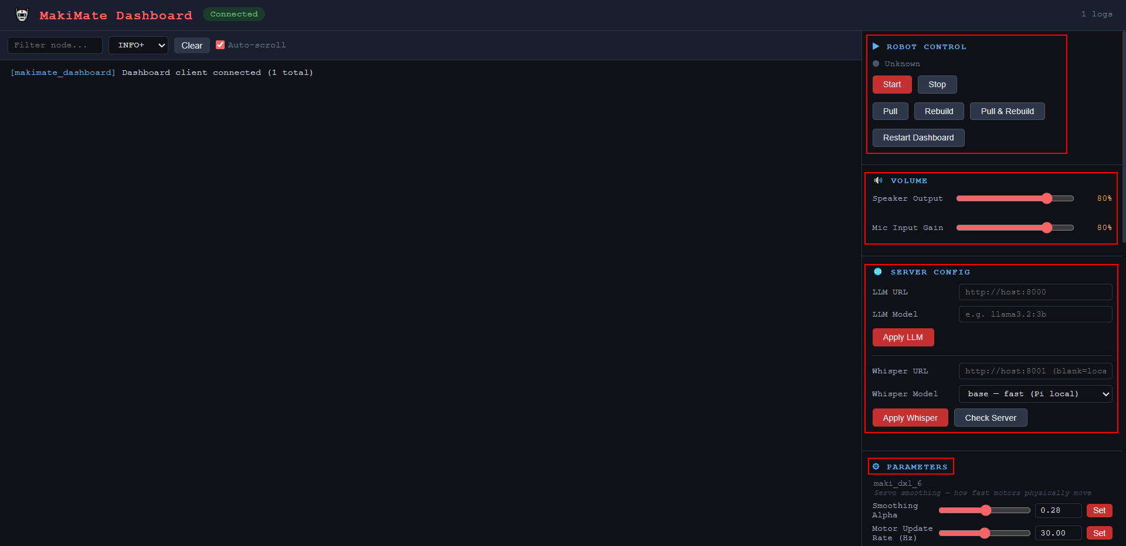
Group 9

Slide 8
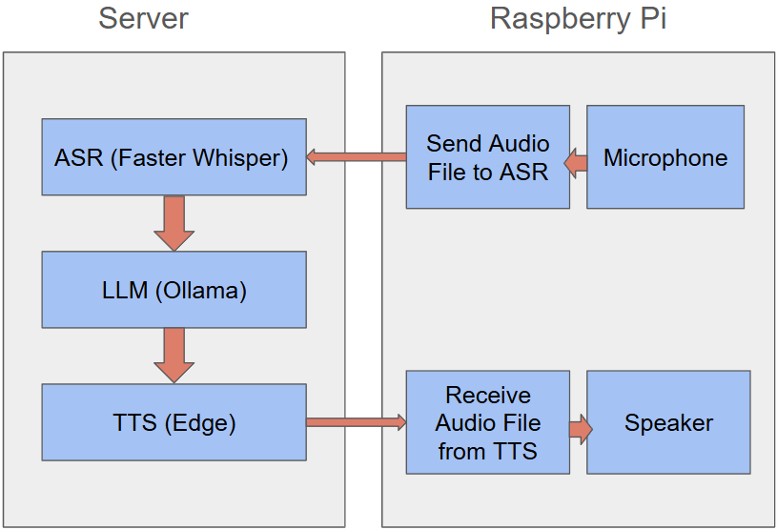

LLM driven Conversational Ability
ASR → LLM → TTS Pipeline
Faster Speeds
Integrated Databases
Reduced Cost

Slide 9

LLM Modularity
Group 9
General Socialization
Specific Uses
  EC Greeter: Directions, Questions
  User Defined Prompt Potential
  Switches Prompts at Click of Button

Slide 10
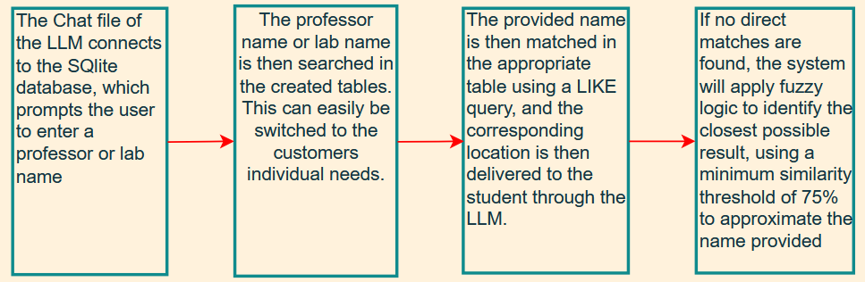
Databases
A database stores information locally in a single file.
After the testing of different databases, we selected SQLite.
It was found to be 50% faster than the next closest tested.
It was then incorporated into Main LLM file.
To help with different accents, Fussy logic was incorporated.

Slide 11
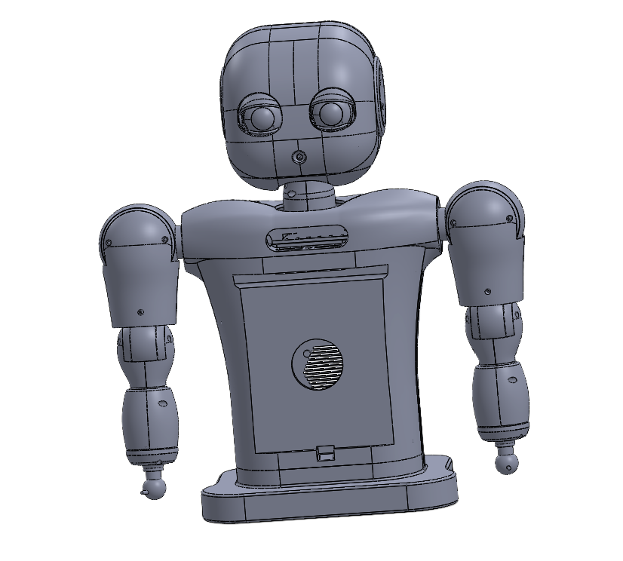
Arm Overview
Comprehensive Design for Gesture Capability
4 DOF per Arm
Bubbly Appearance

Slide 12
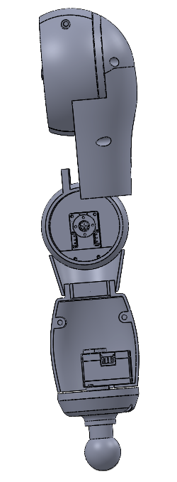
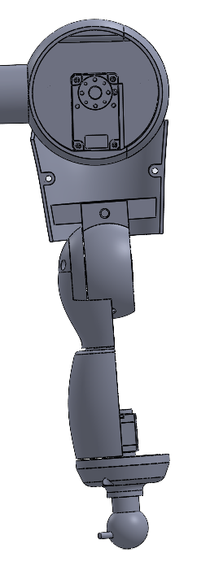
Arm Design
Motor-Driven Revolute Joints
Encapsulated Wires
Easy and Reliable Assembly
Shoulder
Elbow
Wrist

Slide 13
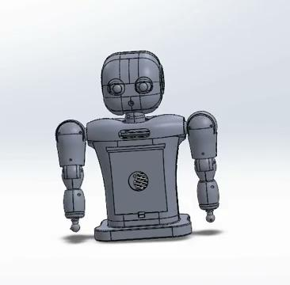
Arm Results
Validated 4-DOF Functionality
Joint ROM exceed targets
  Shoulder 90° (>75°)
  Elbow 80° (>75°)
  Wrist 180° (=180°)
Servos comfortably provide required torque
  Wrist: 0.104N (> 0.02N)
  Elbow: 0.3N (> 0.27N)
  Shoulder: 0.82N (= 0.82N)

Slide 14
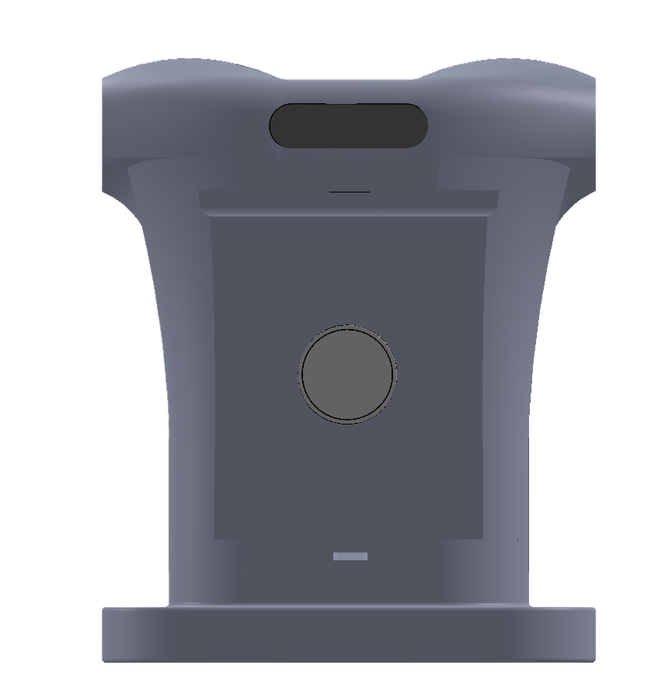
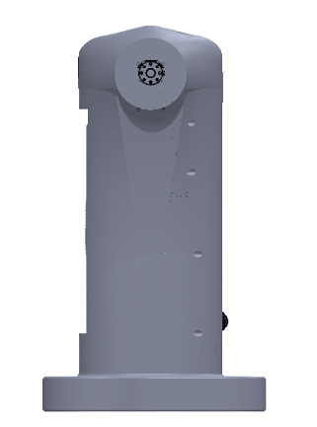
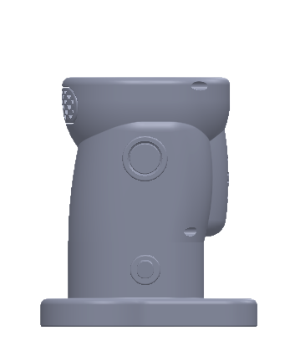
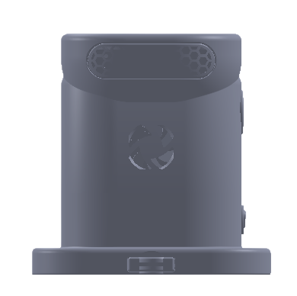
Torso Design Evolution
Group 9
Height: 7.2 in Width: 5.4 in Depth: 4 in
Height: 13 in Width: 8 in Depth: 5 in
Dimensions meet “baby schema” proportion criteria
Supports tablet integration & future hardware expansion
Supports Arm Integration

Slide 15
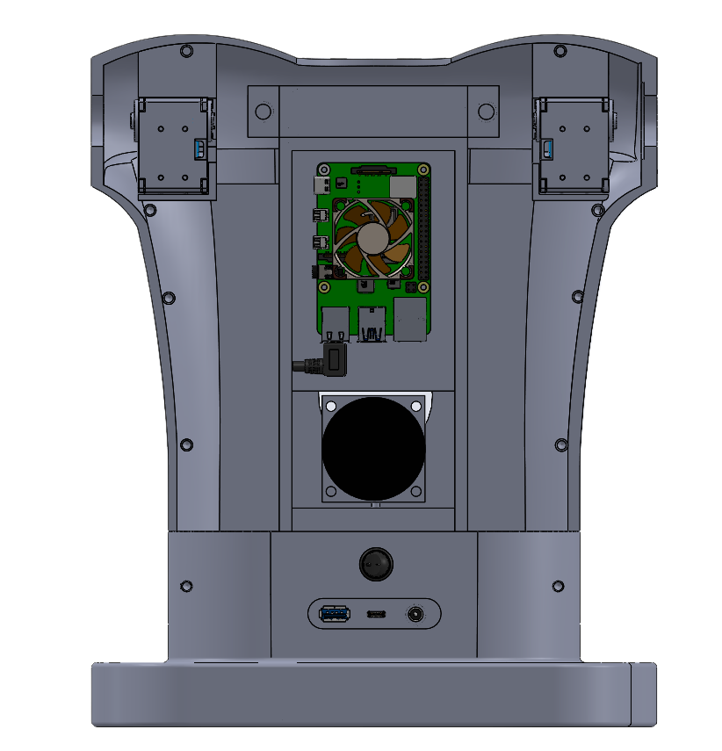
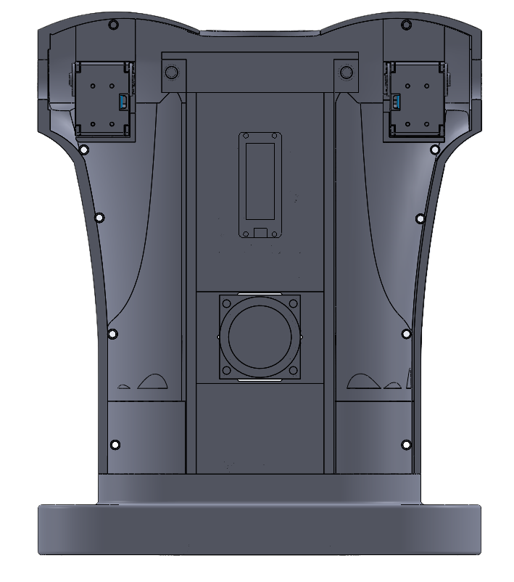

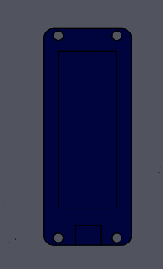

Internal Design
Group 9
Raspberry Pi 5
CS30 RGB Depth Camera
40mm Cooling Fan
Dynamixel XM 430 Servos
2 Inch Arduino Speaker
Open CM9.04 Microcontroller
Rocker Power Switch
M5 Screws/Threaded Brass Inserts
Mini Digital Amplifier Board
USB-A Port
USB-C Port
DC Power Jack

Slide 16
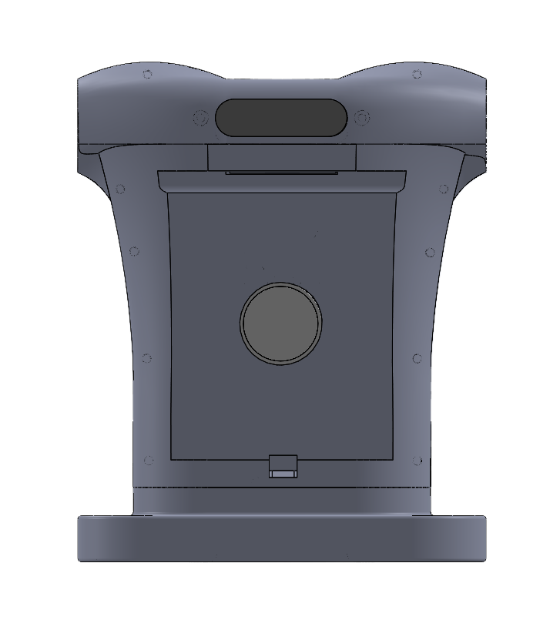
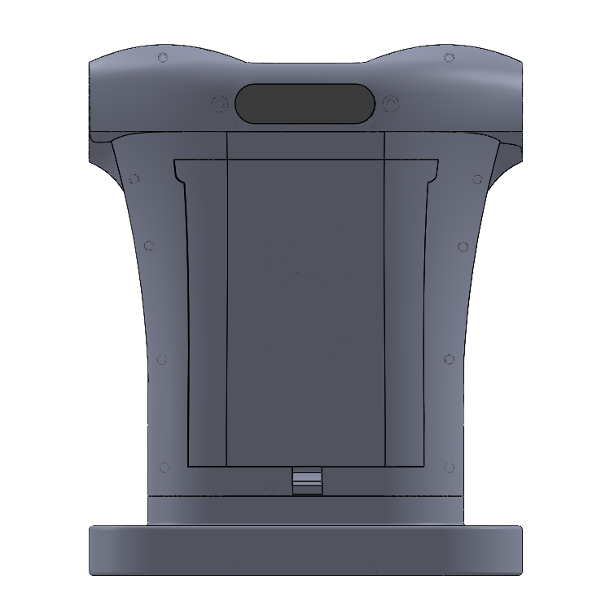
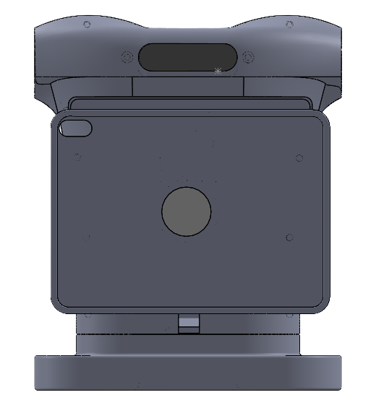
Tablet Integration
Spring clip retention for quick and tool-less swapping
Removable tablet holder with integrated Mag-Safe charging
Interchangeable cover panel for smooth exterior finish

Slide 17
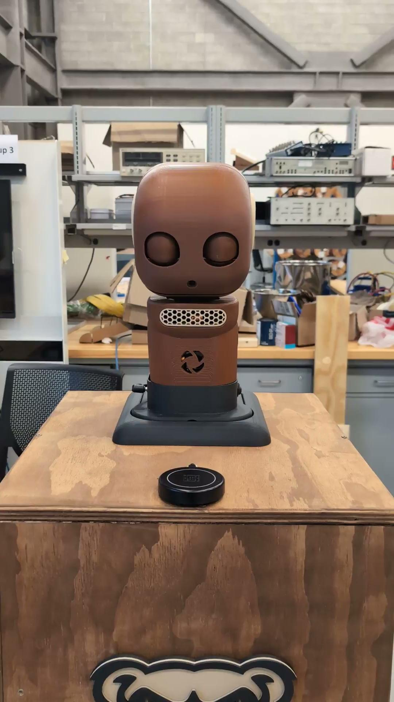
Group 9

Slide 18

Group 9

Slide 19
Demo Hardware
Last Semester
12th Gen Intel i9
RTX 5050
This Semester
Ryzen 5 5500u
No dedicated GPU

Slide 20
Thank you!

